Slide 1
Lesson 6:
Worshiping and Serving God in One of His Churches
Basic Bible Truths

Slide 2
Lesson Plan and Agenda
Looking at the World through the Eyes of God
The Hopelessness of a Wrong Relationship with God
What God has Done for the Lost World
How to Appropriate What God has Done
Elements of Fellowship and Fruitfulness with God
Worshiping and Serving God in One of His Churches

Slide 3
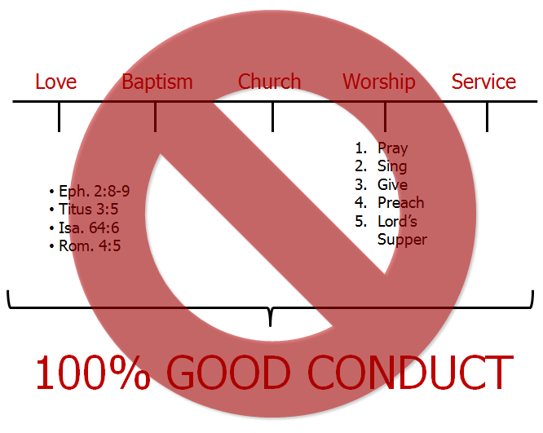
GOD
GOSPEL
Romans 14:11-12
Romans 2:2
John 17:17
Construction
Prophecies
Bible Claims
II Peter 1:21
II Timothy 3:16
I Corinthians 2:9-10
Rom. 1:16
I. Cor. 15:1-4
Death
Burial
Resurrection
Hebrews 6:6
I Samuel 16:7
U
NEW BIRTH
John 3:1-14
I John 5:1
BIRTH
John 3:36
“Relationship”
“NO Relationship”
BELIEVE
Saved – Eph. 2:8-9
Justified – Romans 5:1
Forgiven – Eph. 1:7
Righteous – Romans 3:2
Eternal Life in Christ Jesus – John 5:24
Eternity with God – John 14:1-3
Lost – Luke 19:10
Condemned – John 3:18
Unforgiven – Acts 13: 38-39
Unrighteous – Romans 1:18
Dead in Trespasses & Sins – Eph. 2:1
Eternity in the Lake of Fire – Revelation 20:14-15
Gen. 3:21
Gen. 22:1-4
Exodus 12
Isa. 53:7
Heb. 9:12
Heb. 10:1
Gal. 3:24-26
John 1:29
Acts 8:32-35
I Pet. 3:18
I Pet. 2:24
Rom. 5:6-8
Heb. 10:10-14
John 19:30
II Cor. 7:19-10
Acts 16:30-31
John 5:24
John 3:15-18
CONDUCT
Fellowship – I John 1
SIN: Isa. 59:1-2
DISCIPLINE: Heb. 12:5-11
CONFESSION: I John 1:9
Heb. 4:14-16
John 10:10
Col. 2:6
Love
Baptism
I Pet. 4:8
II Cor. 5:14
I Cor. 13:1-3
I Cor. 10:31
Acts 2:41
Acts 16:33

Slide 4
Then they that gladly received his word were baptized: and the same day there were added unto them about three thousand souls.
- Acts 2:41
And he took them the same hour of the night, and washed their stripes; and was baptized, he and all his, straightway.
- Acts 16:33
“Relationship”
Love
Baptism
I Pet. 4:8
II Cor. 5:14
I Cor. 13:1-3
I Cor. 10:31
Acts 2:41
Acts 16:33

Slide 5
“Picture of the Gospel”
(4) Therefore we are buried with him by baptism into death: that like as Christ was raised up from the dead by the glory of the Father, even so we also should walk in newness of life.
(5) For if we have been planted together in the likeness of his death, we shall be also in the likeness of his resurrection:
- Romans 6:4-5
“Relationship”
Love
Baptism
I Pet. 4:8
II Cor. 5:14
I Cor. 13:1-3
I Cor. 10:31
Acts 2:41
Acts 16:33
“Picture of the Gospel”
Rom. 6:4-5

Slide 6
1. BELIEVER REQUIRED
(36) And as they went on their way, they came unto a certain water: and the eunuch said, See, here is water; what doth hinder me to be baptized?
(37) And Philip said, If thou believest with all thine heart, thou mayest. And he answered and said, I believe that Jesus Christ is the Son of God.
- Acts 8:36-37
2. IMMERSION REQUIRED
(38) And he commanded the chariot to stand still: and they went down both into the water, both Philip and the eunuch; and he baptized him.
(39) And when they were come up out of the water, the Spirit of the Lord caught away Philip, that the eunuch saw him no more: and he went on his way rejoicing.
- Acts 8:38-39
3. AUTHORITY REQUIRED
(19) Go ye therefore, and teach all nations, baptizing them in the name of the Father, and of the Son, and of the Holy Ghost:
(20) Teaching them to observe all things whatsoever I have commanded you: and, lo, I am with you always, even unto the end of the world. Amen.
- Matthew 28:19 & 20
“Relationship”
Love
Baptism
I Pet. 4:8
II Cor. 5:14
I Cor. 13:1-3
I Cor. 10:31
Acts 2:41
Acts 16:33
“Picture of the Gospel”
BELIEVER
IMMERSION
AUTHORITY
Rom. 6:4-5

Slide 7
(41) Then they that gladly received his word were baptized: and the same day there were added unto them about three thousand souls.
(47) Praising God, and having favour with all the people. And the Lord added to the church daily such as should be saved.
- Acts 2:41 & 47
Unto him be glory in the church by Christ Jesus throughout all ages, world without end. Amen.
- Ephesians 3:21
(24) And let us consider one another to provoke unto love and to good works:
(25) Not forsaking the assembling of ourselves together, as the manner of some is; but exhorting one another: and so much the more, as ye see the day approaching.
- Hebrews 10:24 & 25
“Relationship”
Love
Baptism
Church
I Pet. 4:8
II Cor. 5:14
I Cor. 13:1-3
I Cor. 10:31
Acts 2:41
Acts 16:33
Acts 2:41&47
Eph. 3:21
Heb. 10:24-25
“Picture of the Gospel”
BELIEVER
IMMERSION
AUTHORITY
Rom. 6:4-5

Slide 8
(23) But the hour cometh, and now is, when the true worshippers shall worship the Father in spirit and in truth: for the Father seeketh such to worship him.
(24) God is a Spirit: and they that worship him must worship him in spirit and in truth.
- John 4:23 & 24
“Relationship”
Love
Baptism
Church
Worship
I Pet. 4:8
II Cor. 5:14
I Cor. 13:1-3
I Cor. 10:31
Acts 2:41
Acts 16:33
Acts 2:41&47
Eph. 3:21
Heb. 10:24-25
Singing
Giving
Praying
Preaching
Lord’s Supper
John 4:23-24
“Picture of the Gospel”
BELIEVER
IMMERSION
AUTHORITY
Rom. 6:4-5

Slide 9
(31) When the Son of man shall come in his glory, and all the holy angels with him, then shall he sit upon the throne of his glory:
(32) And before him shall be gathered all nations: and he shall separate them one from another, as a shepherd divideth his sheep from the goats:
- Matthew 25:31-40
(33) And he shall set the sheep on his right hand, but the goats on the left.
(34) Then shall the King say unto them on his right hand, Come, ye blessed of my Father, inherit the kingdom prepared for you from the foundation of the world:
- Matthew 25:31-40
(35) For I was an hungred, and ye gave me meat: I was thirsty, and ye gave me drink: I was a stranger, and ye took me in:
(36) Naked, and ye clothed me: I was sick, and ye visited me: I was in prison, and ye came unto me.
- Matthew 25:31-40
(37) Then shall the righteous answer him, saying, Lord, when saw we thee an hungred, and fed thee? or thirsty, and gave thee drink?
(38) When saw we thee a stranger, and took thee in? or naked, and clothed thee?
- Matthew 25:31-40
(39) Or when saw we thee sick, or in prison, and came unto thee?
(40) And the King shall answer and say unto them, Verily I say unto you, Inasmuch as ye have done it unto one of the least of these my brethren, ye have done it unto me.
- Matthew 25:31-40
For we are his workmanship, created in Christ Jesus unto good works, which God hath before ordained that we should walk in them.
- Ephesians 2:10
“Relationship”
Putting Things in the Right Order!
Love
Baptism
Church
Worship
Service
I Pet. 4:8
II Cor. 5:14
I Cor. 13:1-3
I Cor. 10:31
Acts 2:41
Acts 16:33
Acts 2:41&47
Eph. 3:21
Heb. 10:24-25
Singing
Giving
Praying
Preaching
Lord’s Supper
John 4:23-24
Matt. 25:31-40
Eph. 2:10
“Picture of the Gospel”
BELIEVER
IMMERSION
AUTHORITY
Rom. 6:4-5

Slide 10
GOD
GOSPEL
Romans 14:11-12
Romans 2:2
John 17:17
Construction
Prophecies
Bible Claims
II Peter 1:21
II Timothy 3:16
I Corinthians 2:9-10
Rom. 1:16
I. Cor. 15:1-4
Death
Burial
Resurrection
Hebrews 6:6
I Samuel 16:7
U
NEW BIRTH
John 3:1-14
I John 5:1
BIRTH
John 3:36
“Relationship”
“NO Relationship”
BELIEVE
Saved – Eph. 2:8-9
Justified – Romans 5:1
Forgiven – Eph. 1:7
Righteous – Romans 3:2
Eternal Life in Christ Jesus – John 5:24
Eternity with God – John 14:1-3
Lost – Luke 19:10
Condemned – John 3:18
Unforgiven – Acts 13: 38-39
Unrighteous – Romans 1:18
Dead in Trespasses & Sins – Eph. 2:1
Eternity in the Lake of Fire – Revelation 20:14-15
Gen. 3:21
Gen. 22:1-4
Exodus 12
Isa. 53:7
Heb. 9:12
Heb. 10:1
Gal. 3:24-26
John 1:29
Acts 8:32-35
I Pet. 3:18
I Pet. 2:24
Rom. 5:6-8
Heb. 10:10-14
John 19:30
II Cor. 7:19-10
Acts 16:30-31
John 5:24
John 3:15-18
CONDUCT
Fellowship – I John 1
SIN: Isa. 59:1-2
DISCIPLINE: Heb. 12:5-11
CONFESSION: I John 1:9
Heb. 4:14-16
John 10:10
Col. 2:6
Love
Baptism
Church
Worship
Service
I Pet. 4:8
II Cor. 5:14
I Cor. 13:1-3
I Cor. 10:31
Acts 2:41 & 47
Eph. 3:21
Heb. 10:24-25
Sing
Give
Pray
Preach
Lord’s Supper
Matt. 25:31-40
Eph. 2:10
Acts 2:41
Acts 16:33
“Picture of
the Gospel”
BELIEVER
IMMERSION
AUTHORITY
Rom. 6:4-5
John 4:23-24

